Slide 1
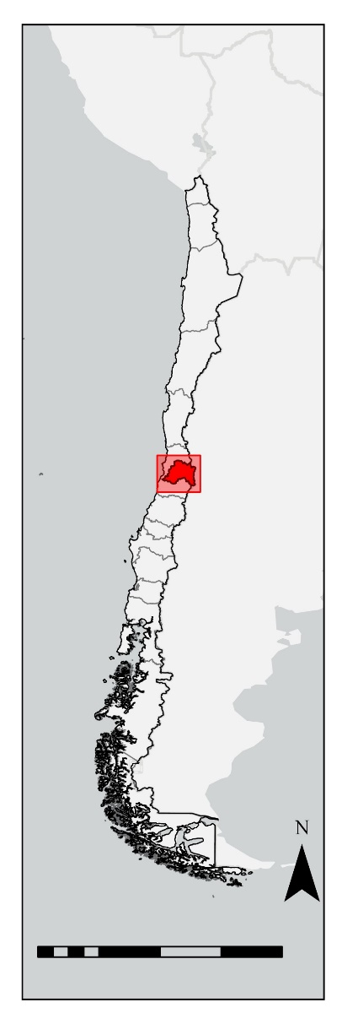
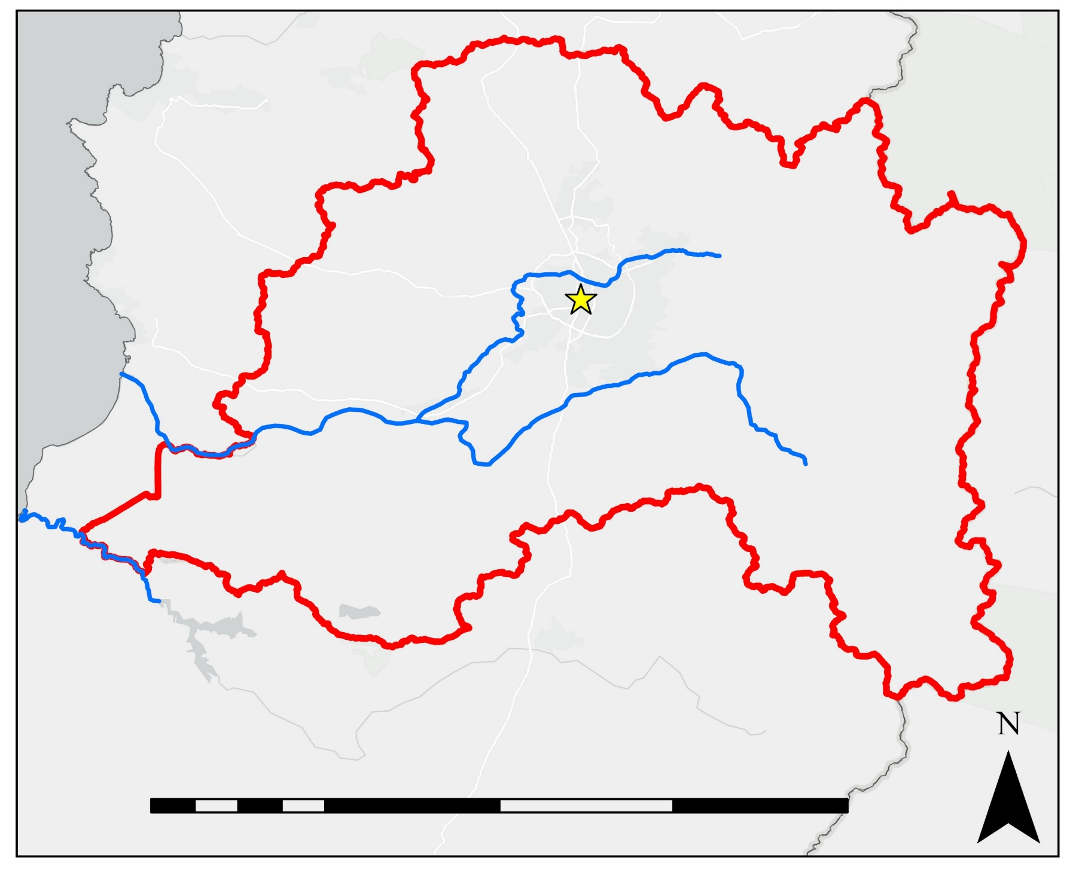
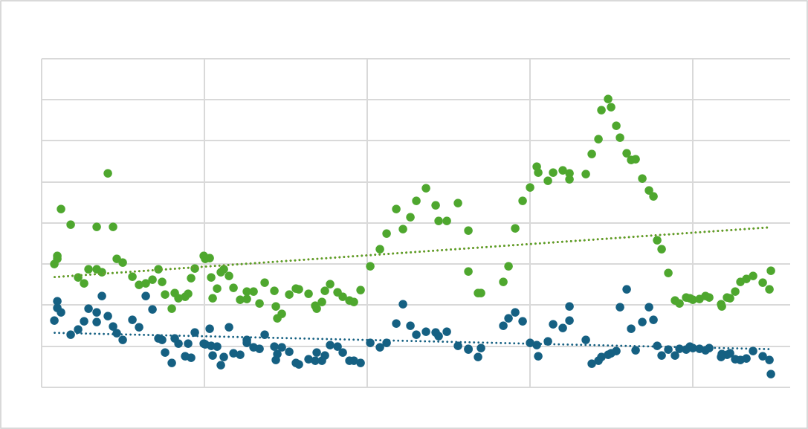
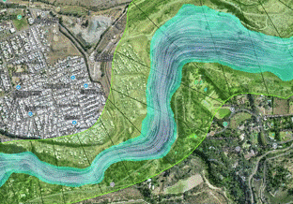
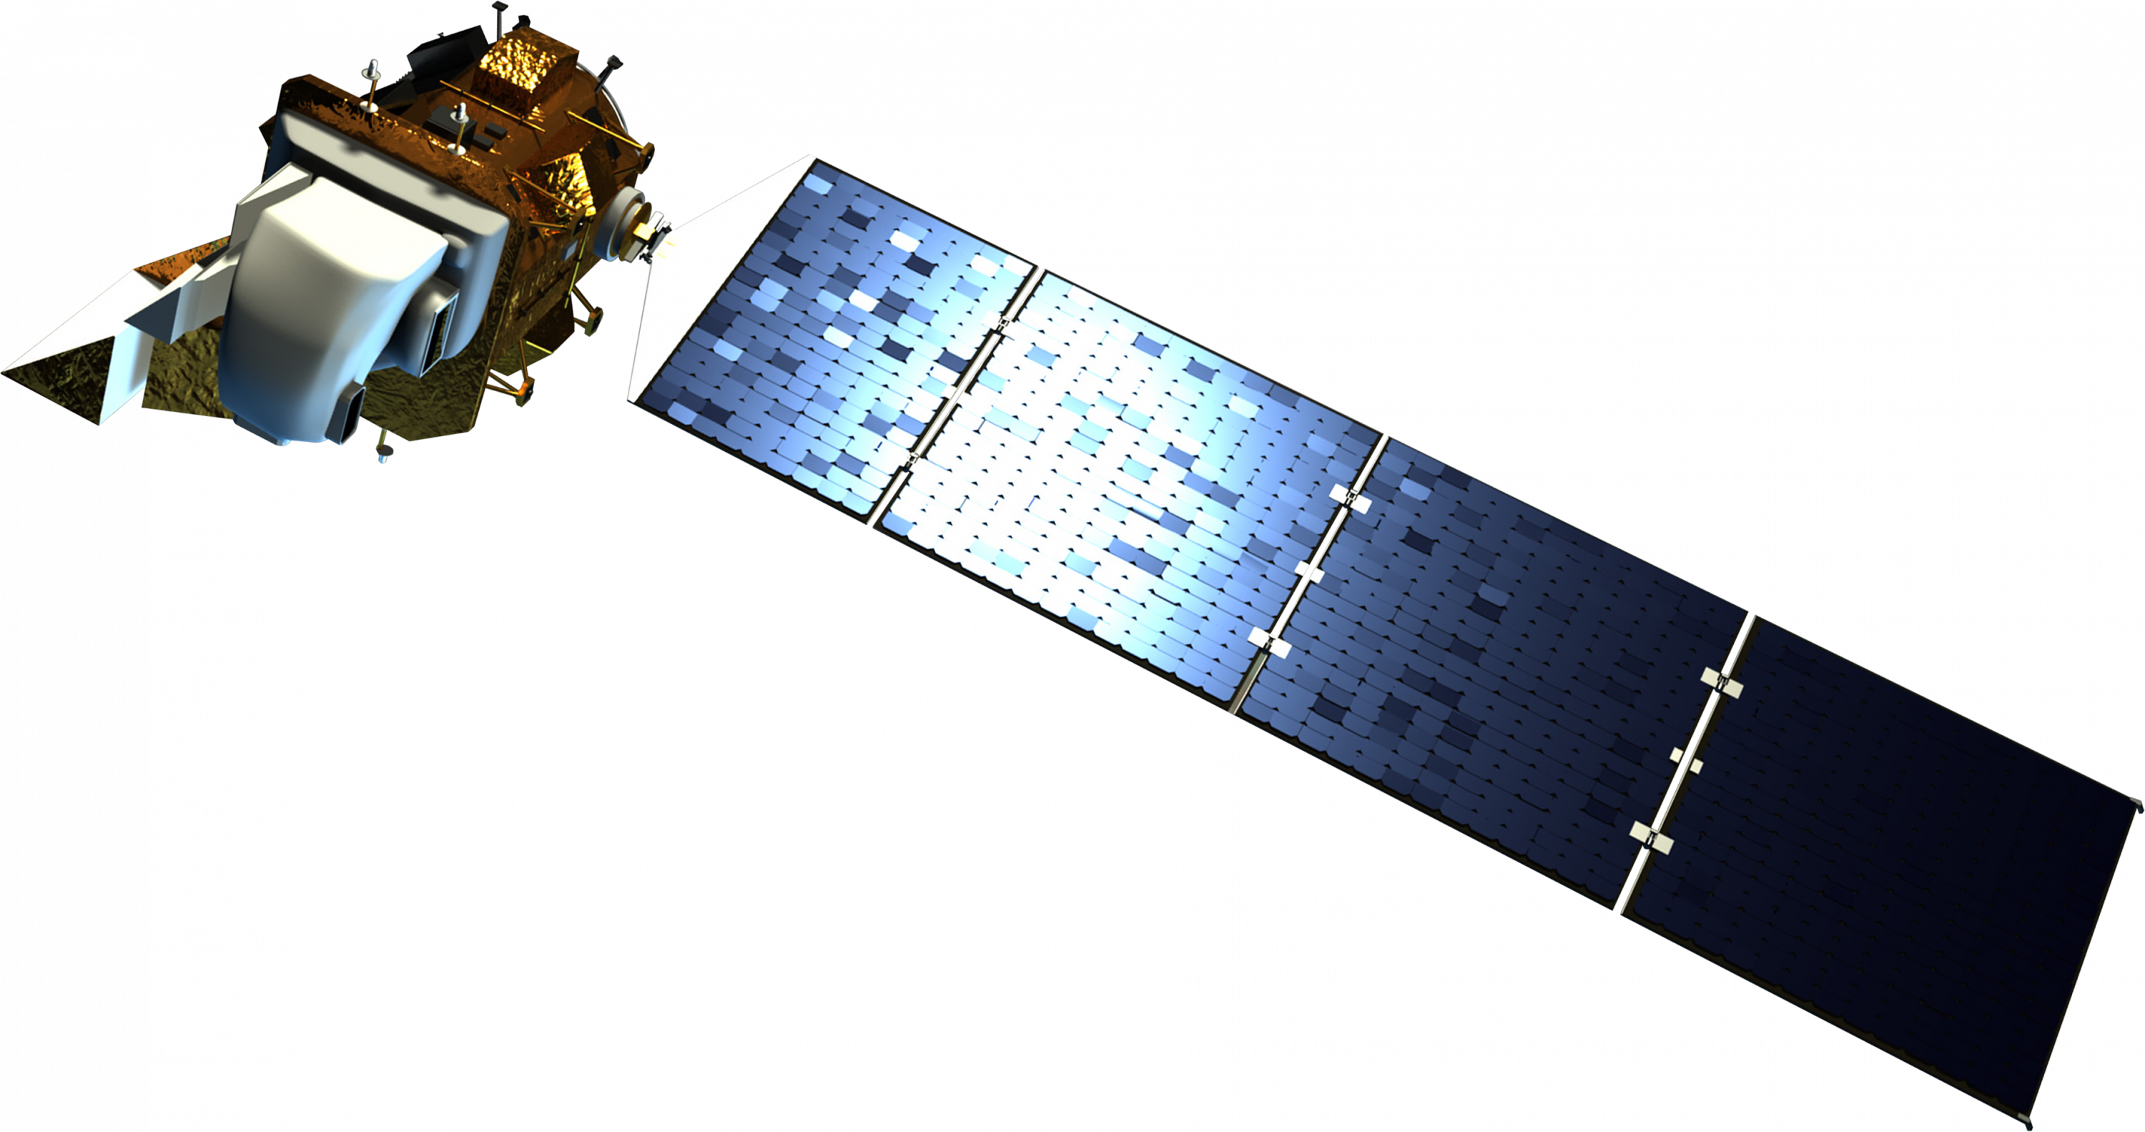
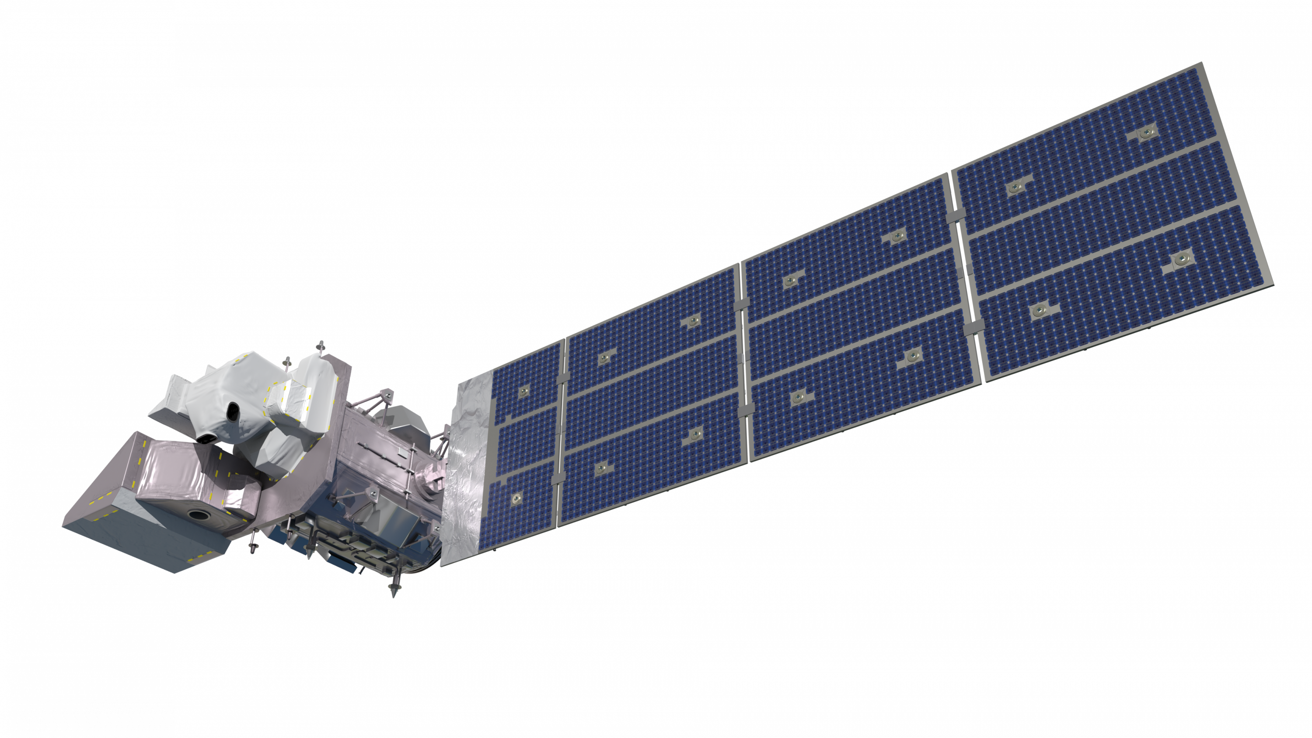
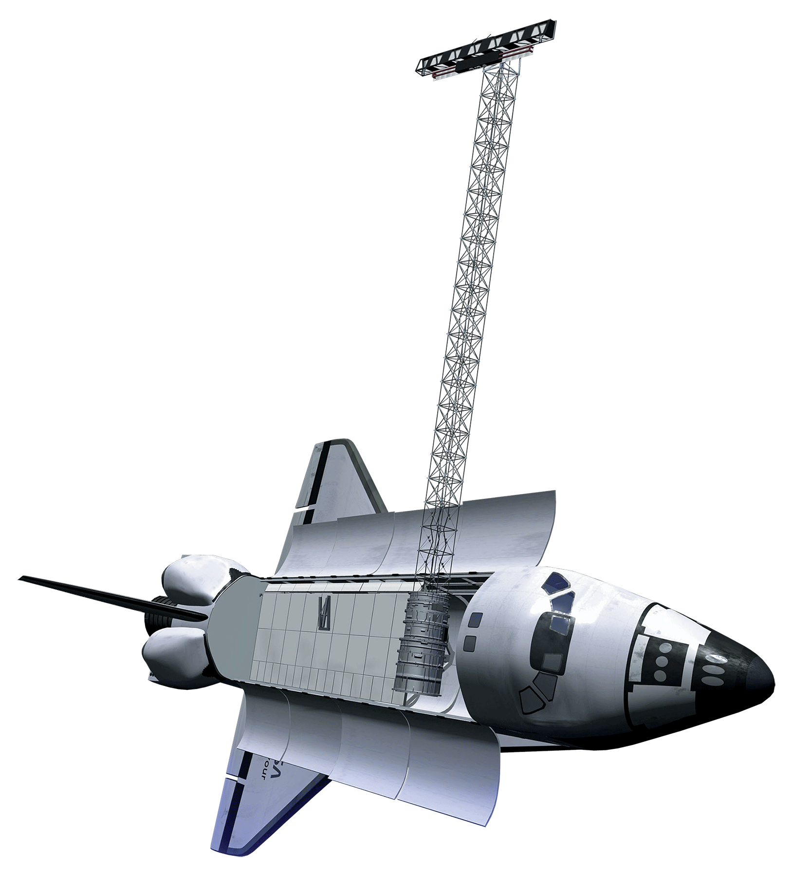
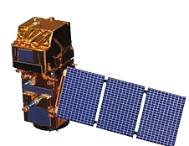
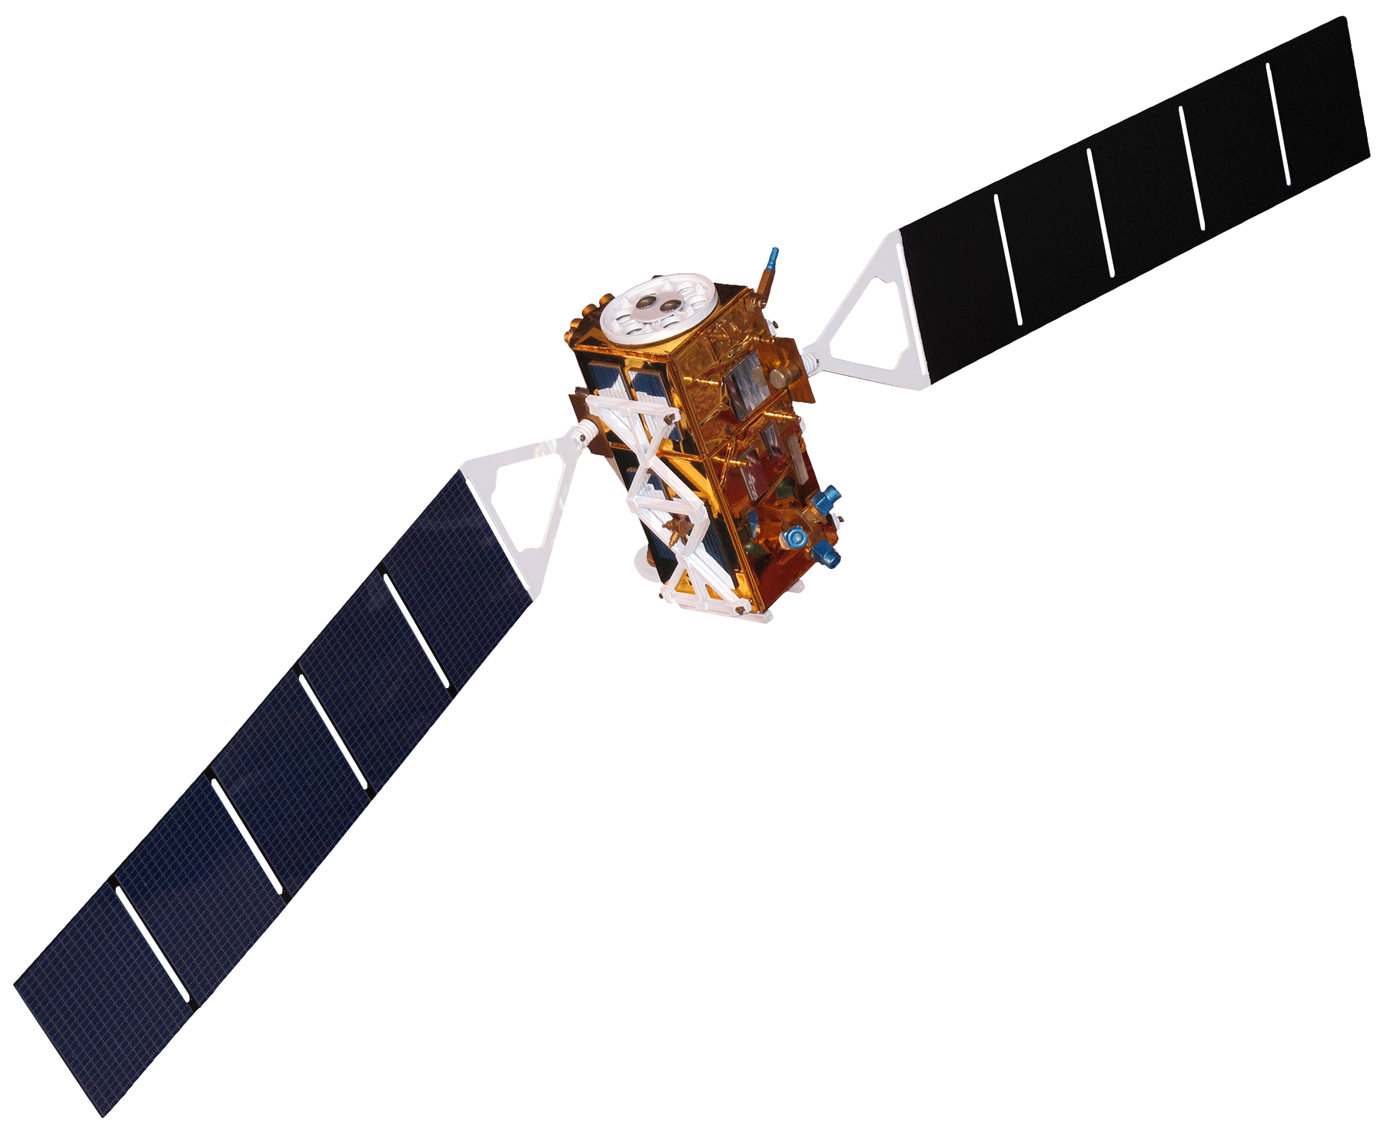
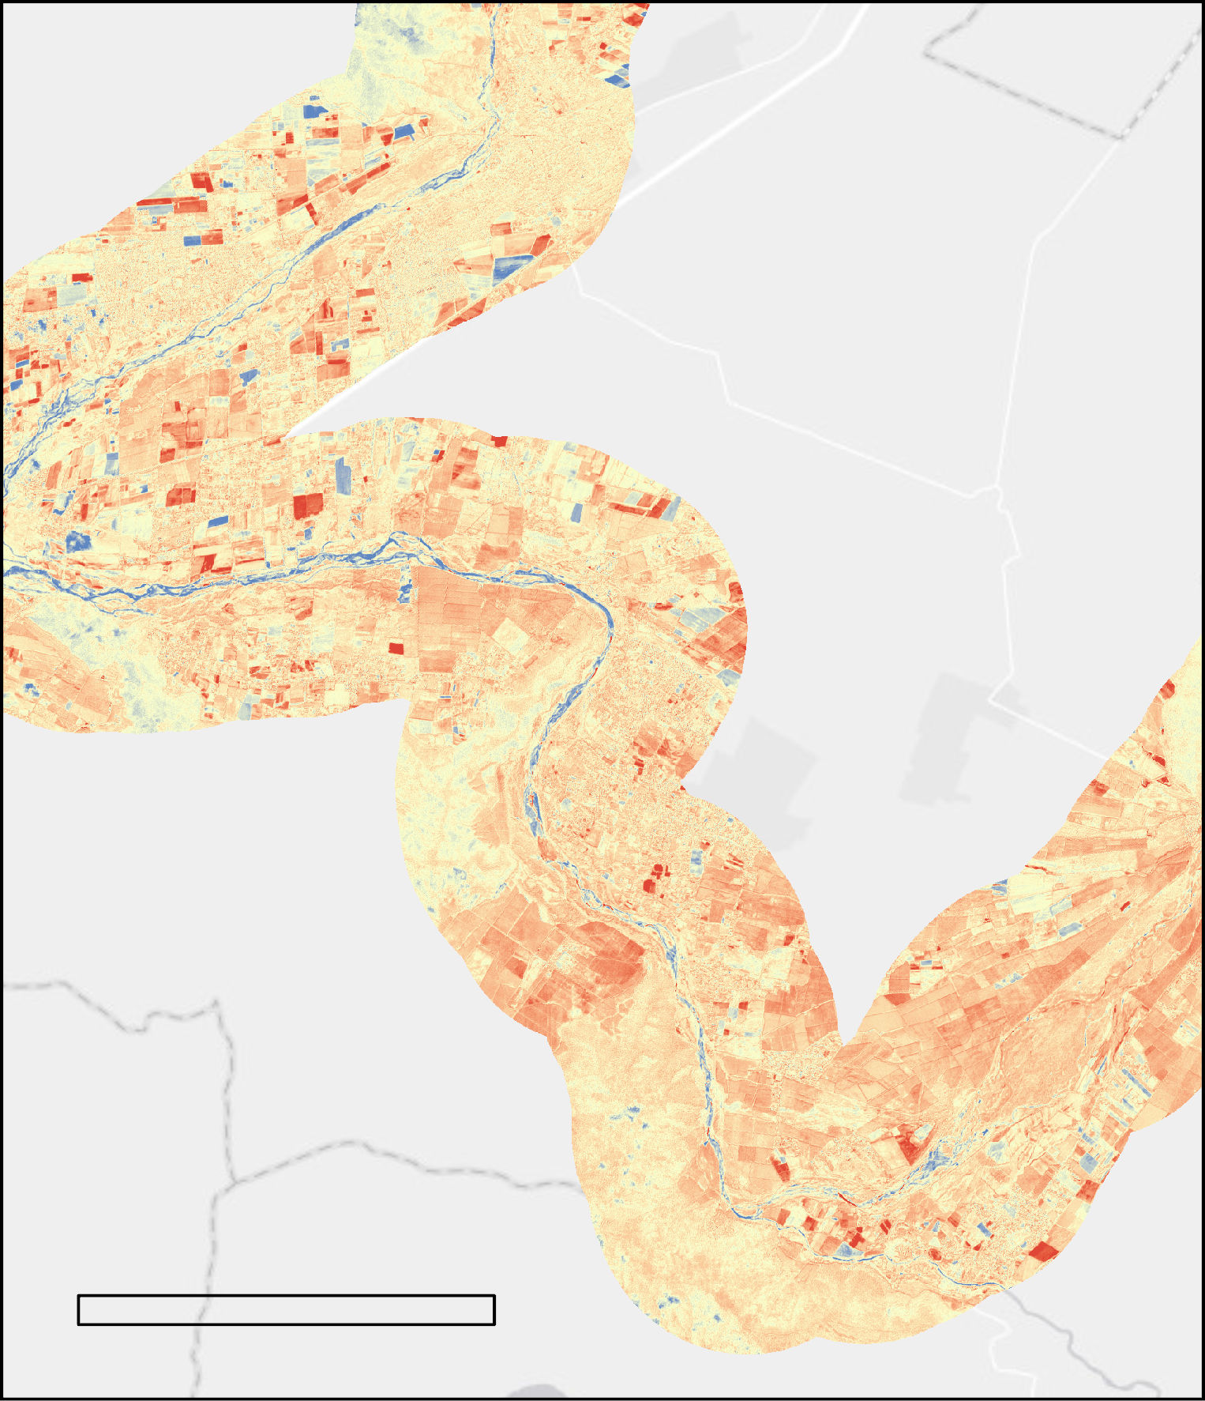
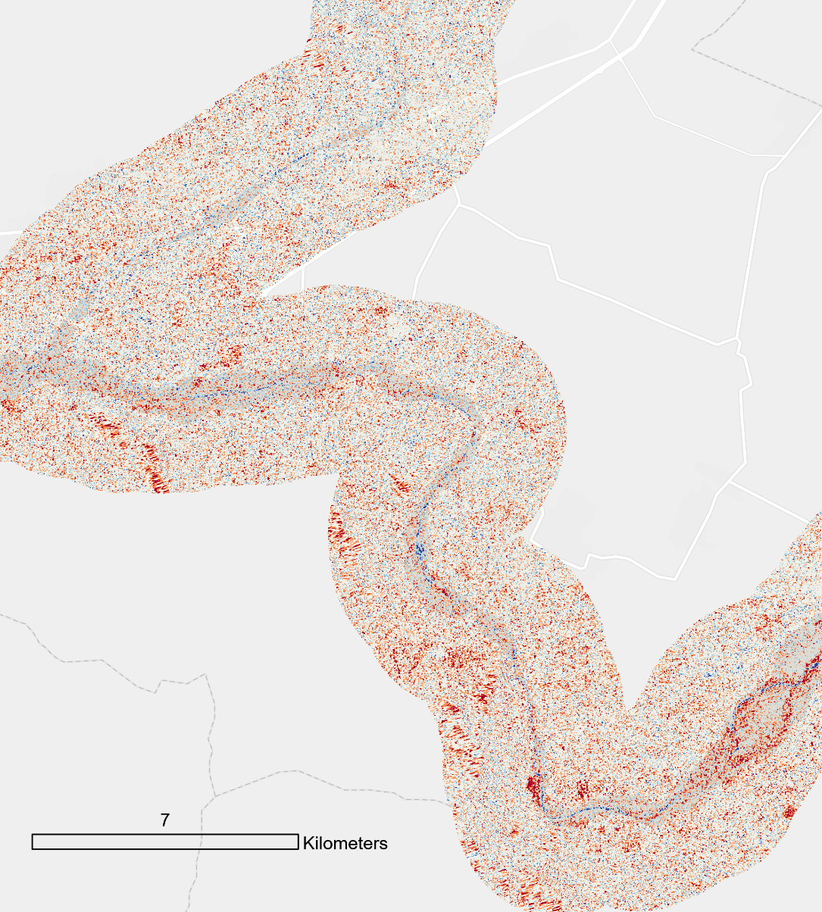






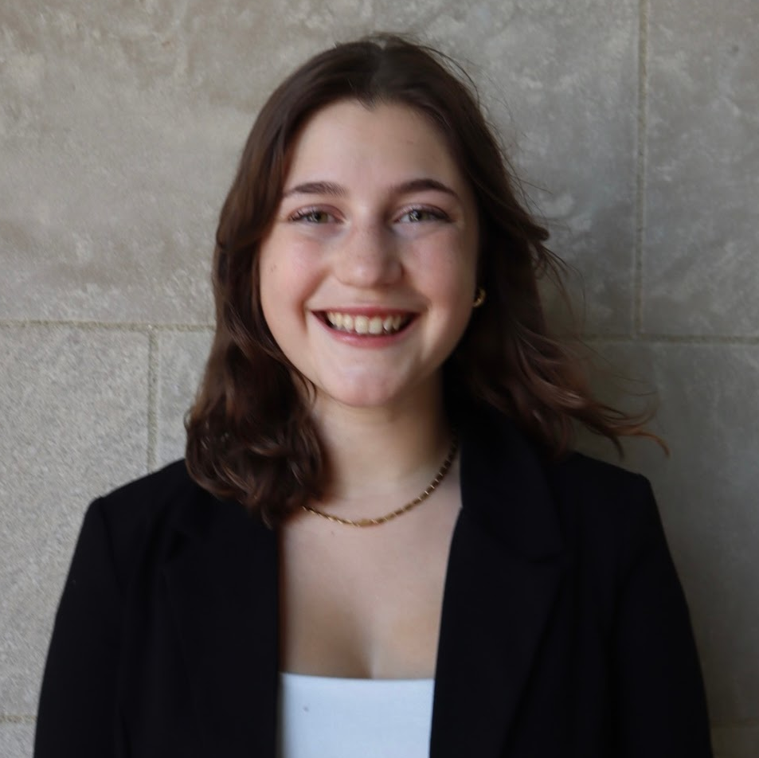
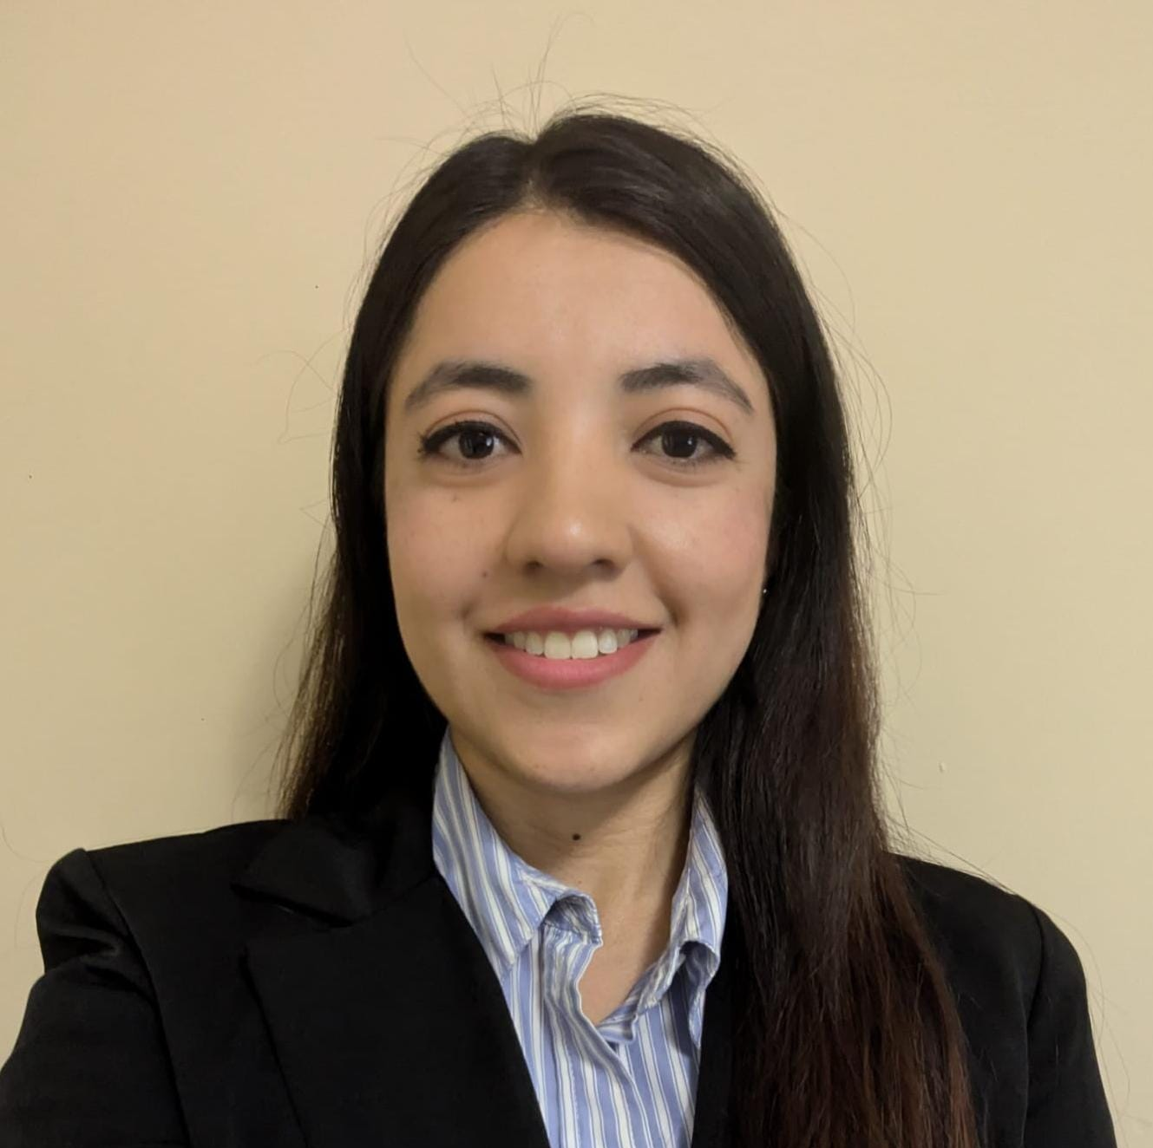


Chile Metropolitan Region Disasters
Enhancing Authority Response to Storm Floods in Chile Leveraging Automatic Satellite Image Processing
Project Synopsis
Study Area
The Metropolitan Region in central Chile is home to approximately 7 million people. The region frequently experiences disastrous floods, impacting tens of thousands of people and millions of dollars in damages. Remote sensing methods used to map flooding extent can help emergency responders allocate resources efficiently. Partnering with Centro de Información de Recursos Naturales (CIREN) in collaboration with the Embassy of Chile Agricultural Office, we leveraged NASA Earth observations and hydraulic modeling to resolve flood extents for recent January 29, 2021, and August 23, 2023, flood events. Compared to the reported August 2023 flooding extents, the Earth observation and hydraulic modeling results were significantly less extensive. Additionally, we found that limited success of using optical and radar datasets to monitor riverine flood extents, while hydraulic modeling provides a more reliable tool for modeling future flood impacts within the Chile Metropolitan Region.
Peru
Bolivia
Valparaíso
Mapocho River
Chile
Santiago
Metropolitan
Region Border
Argentina
Maipo River
Rivers
Objectives
N
Capital
Estimate flood extent within the Metropolitan Region using a hydraulic model
Identify flooded areas in the Metropolitan Region using optical and radar datasets
Assess the feasibility of these methods to map flood extent in the Metropolitan Region
0 1,800
Km
Libertador General Bernardo O'Higgins
N
0 40 80 120 160
Km
Results
Earth Observations
400
August 23, 2023 Floodplain Width with Elevation: Model – CIREN Comparison
350
CIREN
300
Model
250
Floodplain Width (m)
y = 0.27x + 29.76
Landsat 8 OLI
Landsat 9 OLI-2
200
R² = 0.08
150
100
50
y = -0.30x + 401.06
0
R² = 0.08
Shuttle Radar Topography Mission
600
650
700
750
800
Elevation (m)
Sentinel-2 MSI
Sentinel-1 C-SAR
Figure 1a: Evaluation of floodplain width and elevation during the August 23, 2023 flood event
Figure 1b: Comparison of HEC-RAS (blue) and CIREN (green) flood extents for August 23, 2023
Methodology
Optical
January 13 & February 2, 2021
Radar
January 26 & February 1, 2021
Hydraulic Model
Optical
Radar
Change in NDWI
Log Change Difference in Backscatter Value
Data Acquisition
HEC-RAS model
Stream flow data
SRTM 30-m DEM
Land cover
Landsat 8 OLI
Landsat 9 OLI-2
Sentinel-2 MSI
Sentinel-1 C-SAR GRD
Increase in water
Presence of standing water
Decrease in Water
Presence of rough features
Data Processing
Geometry, flow & plan files
Diffusion Wave hydraulic model runs
Mosaic & Clipping
Snow & cloud mask
Normalized Difference Water Index (NDWI)
Radiometric Terrain Correction
Pixel spacing
Scale conversion
Data Analysis
Velocity, discharge, depth, flood extents
Terrain trends, floodplain widths
NDWI change assessment
Log Difference to detect change in backscatter values
7 Km
7 Km
Figure 2a: Change in water as calculated from optical data from the January 29, 2021 flood event
Figure 2b: Change in water as calculated from radar data from January 29, 2021 flood event
Project Partners
Conclusions
We were able to resolve flood extents, evaluate flooding trends with elevation, and compare Earth observation methods for flood mapping
We found that hydraulic modeling is a feasible method for characterizing riverine floods, while optical imagery and SAR have limited success given issues with temporal and spatial constraints.
Centro de Información de Recursos Naturales (CIREN)
Embassy of Chile, Agricultural Office
Team Members
Acknowledgements
Science Advisors
Dr. Xia Cai (Langley Research Center)
Dr. Kenton Ross (Langley Research Center)
Center Lead
Alyson Bergamini (VA – Langley)
Geoinformatics Fellow
Brooklyn Appling (VA – Langley)
Project partners and collaborators:​
CIREN
Carlos Calvo Cortés-Monroy
Vanessa Aros
Embassy of Chile
Fernando Vasquez
Andres Rodriguez
Adin Burwell
ASF DAAC
Heidi Kristenson
James Milburn
ESRI
Vinay Viswambharan
Lisa Tanh
Isabella Giordano
Project Lead
Viviana Bravo Ortiz
Jackie Encinas
Patrick O'Shea
Virginia – Langley | Fall 2024

